Slide 1


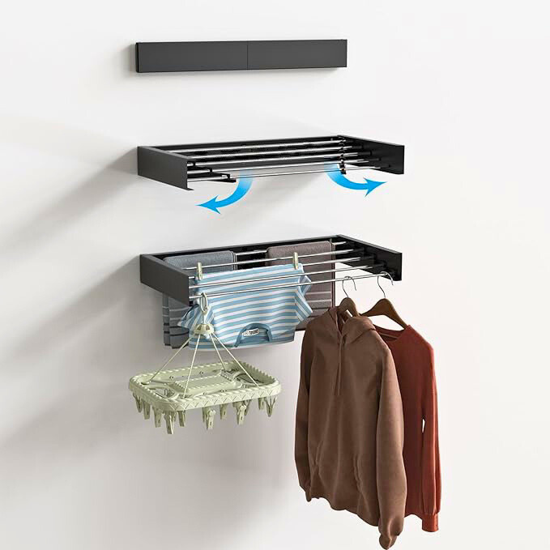
Magic Rack
1
المنشر السحرى
Marketing plan
presentation
For المنشر السحرى- Magic Rack

Slide 2
Magic Rack
Content
المنشر السحرى
1
Business model canvas
Brief
Project overview
Vision
Objective
2
situation analysis
Internal analysis
customer analysis
competitor analysis
swot analysis
3
2

Slide 3








Key Partners
Key Activities
Value Proportions
Customer Relationships
Customer Segments
Suppliers:
To provide raw material
at competitive prices.
Shipping Companies: To deliver products to customers quickly.
Retail Chains: To display the product in their stores.
Manufacturing: Ensuring the quality and design of the product.
Marketing: Running ad campaigns and raising awareness about the product.
Distribution: Delivering the product to customers through various channels.
Customer Service: Providing technical support and handling complaints or suggestions
Space-Saving: The magic clothesline saves space in small areas.
Ease of Use: Easy to install and use without complications.
Indoor-Friendly: Perfect for apartments or places with limited sunlight.
Affordable Price: A practical product at a reasonable price
Moms: Looking for quick and easy solutions for drying clothes.
Students or Young Adults: Living in small apartments with limited space.
Travelers: Need portable and compact drying solutions.
Renters: Looking for practical and affordable solutions for temporary living spaces
Customer Support: Provide technical support for installation or usage issues.
Warranty: Offer a product warranty to build trust.
Social Media Interaction: Respond quickly to customer inquiries.
Loyalty Programs: Discounts or offers for returning customers
Key Resources
Channels
Manufacturer or Supplier: Responsible for producing the product.
Marketing Team: To manage ad campaigns and customer relationships.
Website: To sell the product online.
Warehouses: For storing products before distribution
Social Media: Facebook, Instagram, or TikTok for reaching a wide audience.
Cost Structure
Revenue Streams
Manufacturing Costs: Raw materials and labor.
Marketing Costs: Social media ads .
Distribution Costs: Shipping and delivery expenses.
Customer Service Costs: Salaries for support staff.
Storage Costs: Warehousing or storage facilities
Direct Sales: Selling the product through e-commerce or physical stores.
Advertising: we have website .
Wholesale: Selling to bulk buyers.
Designed For: المنشر السحرى - Magic rack
Business Model Canvas
3

Slide 4

BRIEF: MAGIC RACK
4
Project Overview:
The Magic Clothes Dryer is a locally manufactured product by NATIONAL STEEL Factory, designed to provide a practical and innovative solution for drying clothes easily in small spaces. Thanks to its smart and durable design, the dryer combines high quality with affordability, making it an ideal choice for Egyptian families.
vision:
Goals :
The Magic Clothes Dryer (MAGIC RACK ) - An Innovative Egyptian Product to Simplify Your Daily Life
building a positive image of Egyptian-made products in the home goods sector .
objective:
customer :Promote awareness of the product as a high-quality locally manufactured item.
company : Increase sales in the Egyptian market through effective digital marketing strategies.

Slide 5
Internal Analysis
5
Feature
Advantages
Benifits
1 - Unique and foldable design, lightweight and rust-resistant materials, ease of storage
2 -Using weather-resistant materials, which increases the product's lifespan
3 - materials, which increases the product's lifespan.
4- A reasonable price compared to traditional alternatives
5- it can be openend and folded easily.
1 - Foldability and storage
2 - Rust and corrosion resistant..
3 - supports multiple weights.
4 - Internal and external usability: It can be placed inside the house, on the balcony, or even in gardens, as needed.
5 - Easy to transport and move: Lightweight and easy to carry, making it ideal for travel or transferring between rooms easily.
6- Sleek and modern design: It suits home decor and looks elegant when placed anywhere.
7- Easy and quick assembly:
It does not require complex tools for installation or disassembly, making it user-friendly for everyone.
1 - It addresses the issue of small spaces and provides a practical alternative to the traditional drying rack.
2 - Faster and more efficient drying: It ensures the distribution of clothes in a way that allows air to flow freely, helping to accelerate the drying process compared to traditional drying racks..
3 -Energy-efficient: A natural alternative to electric clothes dryers, helping to reduce electricity consumption..
4 - Carry a large number of clothes at once without affecting its balance or stability.
5

Slide 6

6
Customer Analysis
6

Slide 7
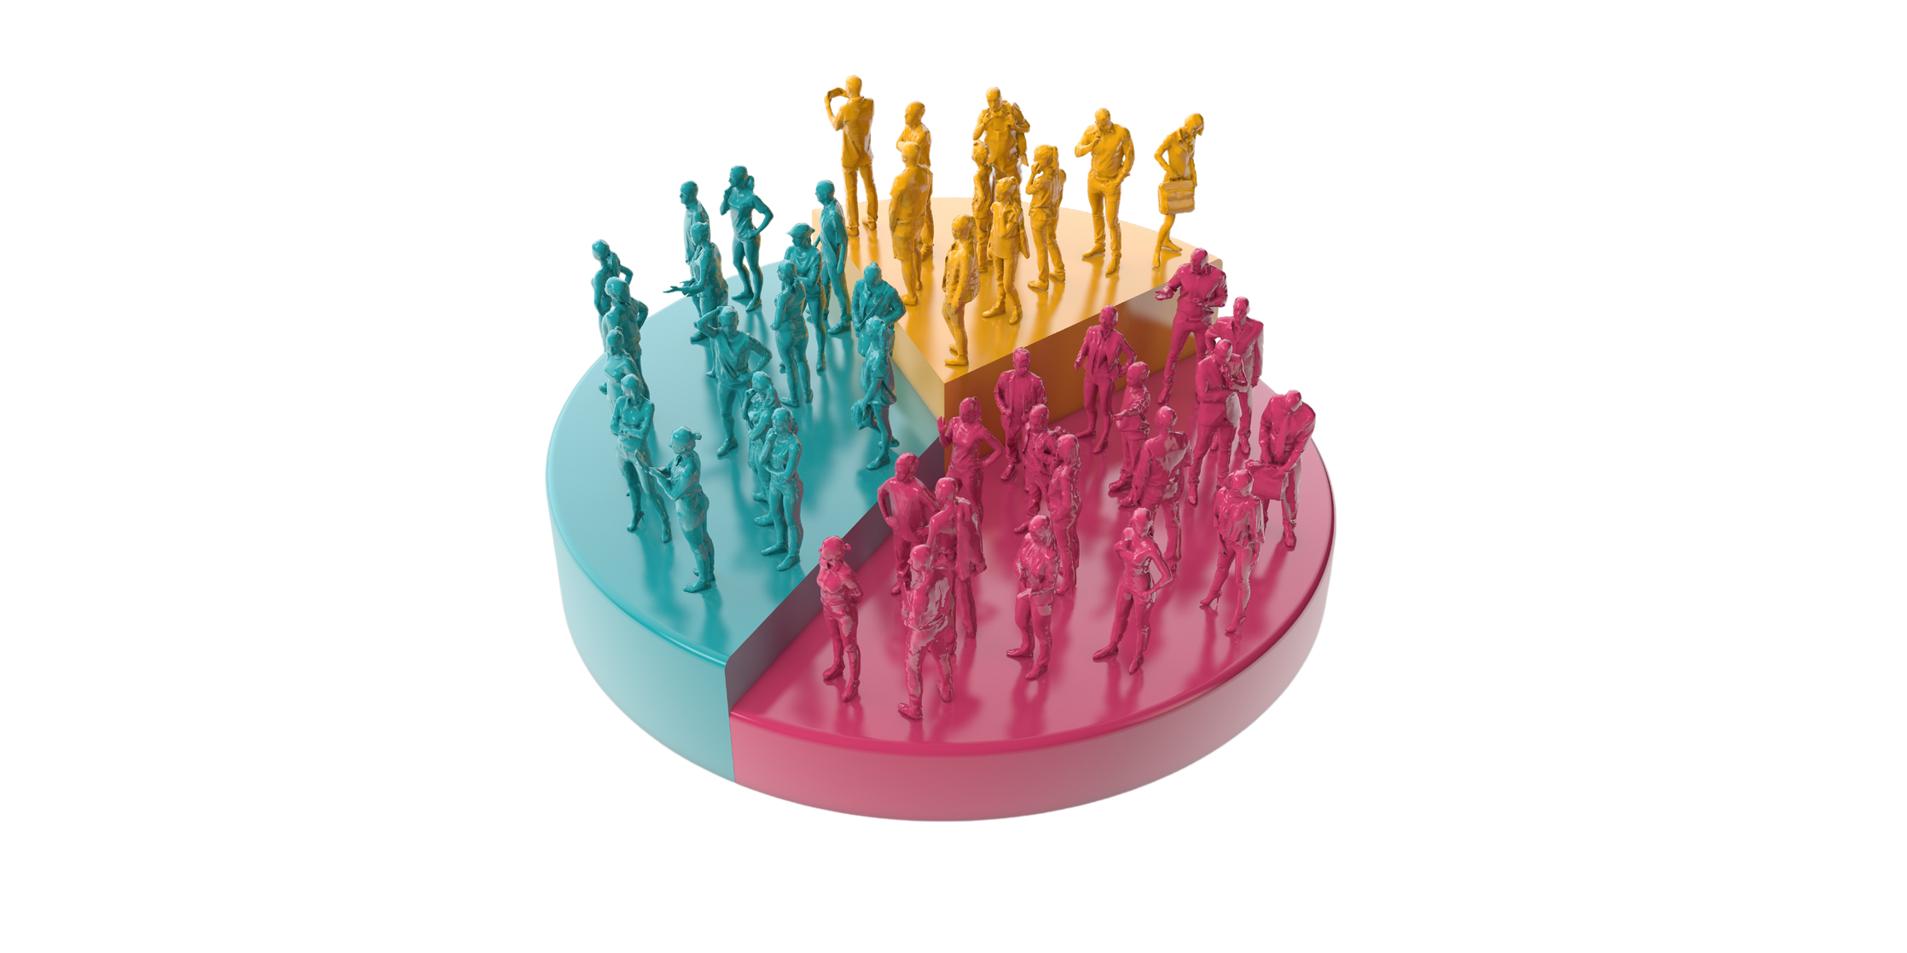
7
Segmentations

Slide 8

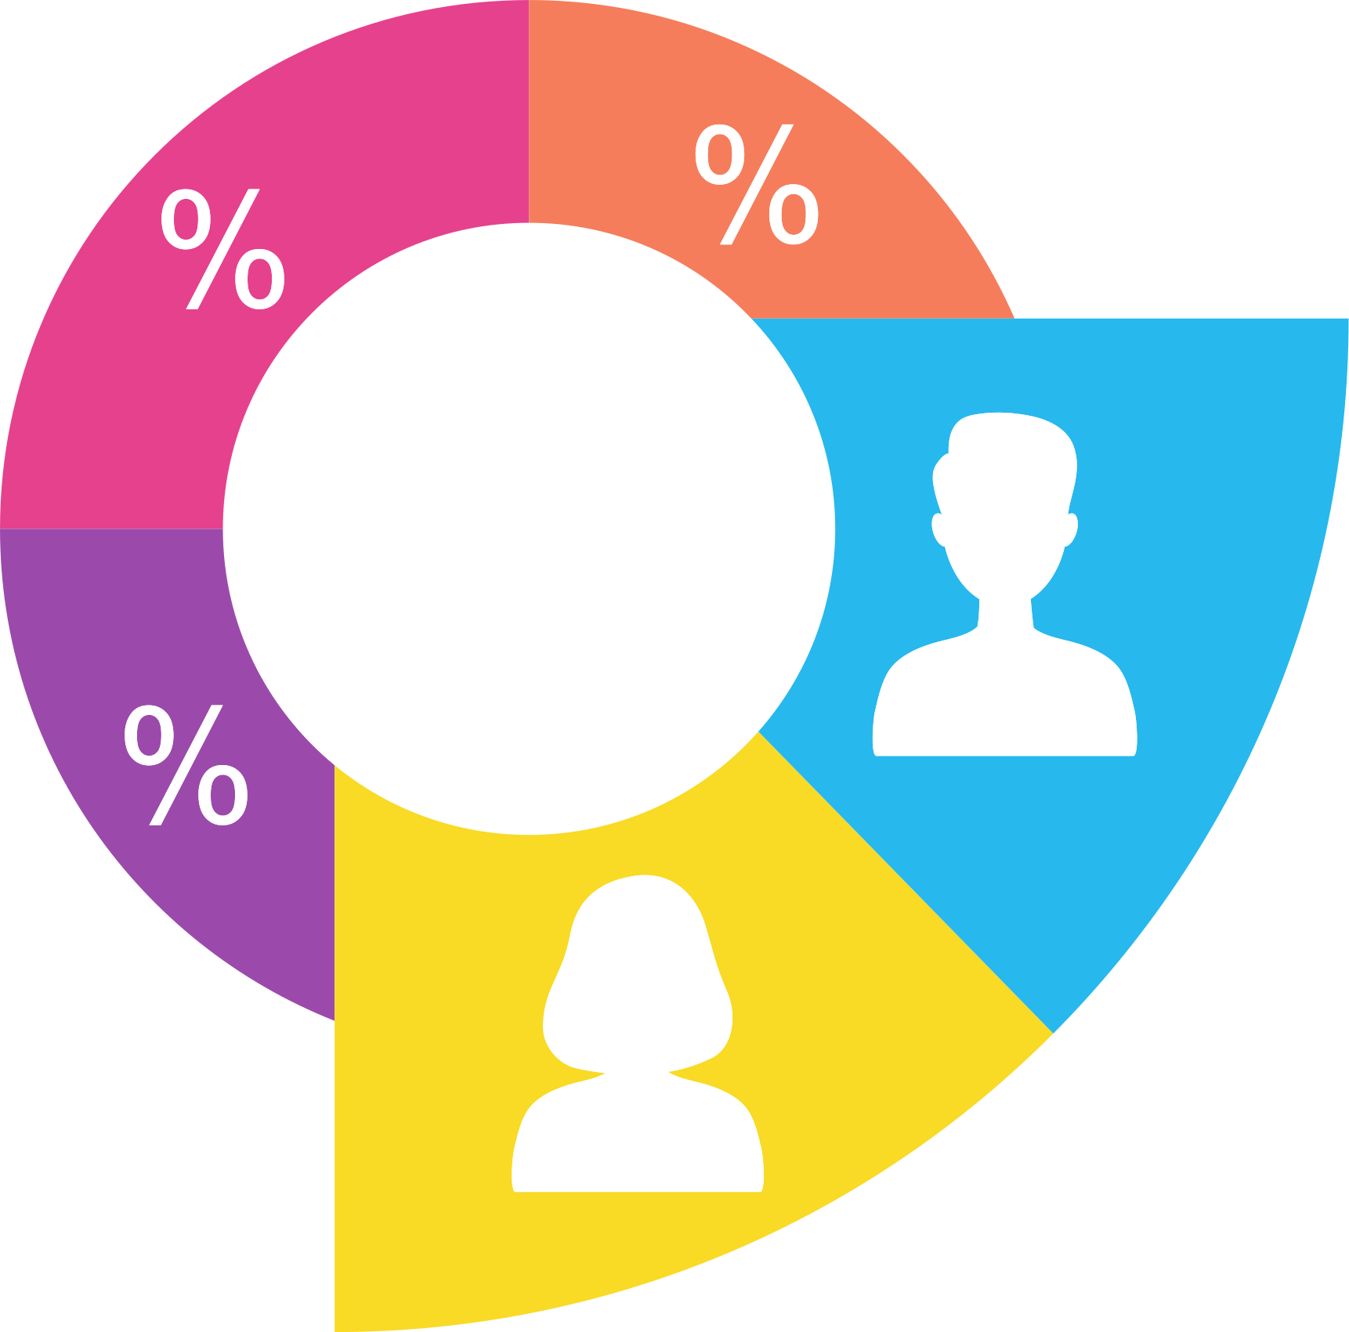


Demographic Segmentation
8
Age
Gender
Income Level
1 - 25–35 years:
Young professionals or newlyweds setting up their homes.
Need compact and stylish solutions for small spaces.
2 - 36–45 years:
Parents or homeowners with families.
Require durable and spacious drying racks for heavy laundry loads.
1 - Women:
Focus on homemakers and working mothers who manage household chores.
2 - Men:
Target bachelors or men living alone who prioritize convenience.
1 - Middle-Income Households:
Value for money is a priority.
Practical features and durability attract this group.
2 - Upper-Middle-Income Households:
Interested in premium design and additional features like adjustable height or sleek finishes.

Slide 9
Geographic Segmentation
Urban Areas
Rural Areas
Apartments with limited balconies or outdoor spaces.
Residents need compact, space-saving solutions.
Installation of outdoor drying racks is prohibited in new cities.
Preference for sturdy, long-lasting racks for outdoor or indoor use.
9

Slide 10

Behavioral Segmentation
10
Buying Habits
Usage Patterns
Loyalty Levels
1 - Online Shoppers:
Prefer convenience and detailed product descriptions.
Use platforms like Jumia, Amazon, or social media ads.
2 - In-Store Shoppers:
Want to see and feel the product before purchasing.
1 - Daily Users:
Households with frequent laundry needs.
2 - Occasional Users:
Individuals or families who do laundry once or twice a week.
1 - First-Time Buyers:
Need reassurance through discounts or guarantees.
2 - Repeat Customers:
Offer loyalty rewards or bundles for additional purchases

Slide 11

Psychographic Segmentation
Lifestyle
Values
1 - Minimalists:
Appreciate sleek, functional designs.
2 - Eco-Conscious Consumers:
Value energy-saving and environmentally friendly products
1 - Quality-Oriented:
Seek durable, long-lasting products.
2 - Cost-Conscious:
Look for affordable options with essential features.
11

Slide 12

Competitor Analysis
12

Slide 13

Competitor1(farhan steel)
Strengths
Weaknesses
Buyer journey
Awareness and interest stage:
give advices around the presence of the product in home and then buyer ask information about the product then buy with offer.
Having only one size reduces the chances of sales and comments on the platform.
1 - Strong follower engagement: This indicates a dedicated and interested audience, which is positive for building brand recognition and boosting sales.
2 - Continuous publishing of existing offers, especially for grills
Non-continuous for continuous deployment of the magic saw.
3 - 3 years warranty- present on snapshat / instagram / tiktok / youtube (not active).
4 - Respond and replay to all comments to increase followers and sales.
1 - Non-continuous for continuous deployment of the magic saw.
2 - There is only one size, one meter, and only 900 pounds Irregular
posts on magic rack .
13

Slide 14

Competitor2(ElBanhawe Group)
Strengths
Weaknesses
Buyer journey
1 - Strong follower engagement: This indicates a dedicated and interested audience, which is positive for building brand recognition and boosting sales.
2 - 3-year warranty. There are 3 types of sawmills deployment of the magic saw.
3 - Publishing every 5 days for three types of sawmills.
1 - irregular content post/ each 5 days not continous.
2 - Not respond to all comments and not always accurate in answers
3- Reply but not always accurate
4- The magic decorative diffuser is not coated with
an electrostatic layer.
Awareness and Interest Stage: Given that the strengths focus on product quality and
offers, customers are likely in the awareness and interest stage of the buyer journey.
This means they are just starting to learn about the platform and are seeking more
information.
14

Slide 15
SWOT
Analysis
15
Strengths
Weaknesses
Opportunities
Threats
1 - Compact and Space-Saving Design:
Ideal for small apartments or homes with limited space.
Foldable and easy to store.
2 - High Durability:
Made from strong materials (e.g., stainless steel) that ensure long-term use.
3 - User-Friendly:
Lightweight, easy to assemble and disassemble.
4 - Affordable Pricing:
Offers value for money compared to similar products.
5 - Versatile Usage:
Suitable for both indoor and outdoor use.
6 - Made Locally (Support for Local Economy):
Appeals to consumers who prefer supporting domestic industries.
1 - Expanding Market Demand:
Increasing demand for space-saving home solutions due to urbanization and smaller living spaces.
2 - E-commerce Growth:
Online platforms like Jumia, Amazon, and social media ads can boost sales and reach a broader audience.
3 - Export Potential:
Expanding to neighboring countries with similar market needs.
4 - Collaboration with Retailers:
Partnering with supermarkets, hypermarkets, and home goods stores to reach more customers.
5 - Innovations and Upgrades:
Adding features like adjustable height, color options, or extra drying tiers.
6 - Focus on Sustainability:
Marketing the product as eco-friendly and energy-saving.
1 - Market Competition:
Competing products from local and international brands with similar features.
2 - Price Wars:
Competitors may lower prices to attract budget-conscious customers.
3 - Economic Fluctuations:
Changes in consumer spending habits due to inflation or economic downturns.
4 - Customer Preferences:
Preference for traditional drying methods in certain areas or cultural resistance to new products.
5 - Logistics and Supply Chain Issues:
Rising costs of raw materials or delivery delays may impact profitability.
1 - Design Limitations:
Might not cater to families with very high laundry loads.
2 - Target Market Constraints:
Predominantly targets middle-income families, limiting appeal to high-end consumers.
3 - Potential for Imitation:
The design could be easily replicated by competitors.

Slide 16
Marketing Mix
Product / Service
Marketed (magic rack)
Price
Place
Promotion
Modern and durable design
official website
Content Marketing
60cm 4 ropes (690 EGP)
Social media channels
Space-saving
80cm 5 ropes (790 EGP)
Paid advertisements
Easy to assemble and disassemble
commercial markets
offers
100cm 6 ropes (850 EGP)
E-commerce stores
Customer Service
Rust-resistant and weatherproof
120cm 6 ropes (890 EGP)
16

Slide 17

strategy
17

Slide 18
Content Strategy
18
Goals
Content Pillars
Content Formats
- Increase brand awareness and engagement.
- Drive sales through targeted content.
- Educate customers on product benefits and usage.
- Build a loyal customer community.
- Short-form videos (Reels, TikToks) showcasing product benefits.
- Carousel posts for step-by-step guides and comparisons.
- Stories for daily engagement and time sensitive promotions.
- Blog posts and infographics for SEO driven content.
- Email newsletters for customer
retention.
- Educational Content :Tips on efficient laundry drying, space-saving hacks, product tutorials.
- Promotional Content : Discounts, offers, and limited-time deals.
- User-Generated Content : Testimonials, reviews, and real-life product usage.
- Engagement Content : Polls, Q&A sessions, and interactive challenges.
- Lifestyle Content : How Magic Rack fits into modern living spaces.
Target Audience
- Homeowners and apartment dwellers with limited space.
- Busy professionals looking for convenient laundry solutions.
- Families needing efficient drying solutions.
- Online shoppers interested in home improvement products.
18

Slide 19
Content Strategy
19
Distribution Channels
Performance Metrics
- Facebook, Instagram, and TikTok for engagement and awareness.
- YouTube for detailed product demonstrations.
- Company website for blog content and customer testimonials.
- Email marketing for direct communication and offers.
- Engagement rate (likes, shares, comments).
- Website traffic and conversion rate.
- Sales attributed to content campaigns.
- Customer feedback and testimonials.
19

Slide 20
20
Magic Rack - Content Calendar
A strategic content plan for marketing Magic Rack effectively in March
20

Slide 21
Day | Content Type | Post Idea | Format
1 | Ramadan Offer | Welcome Ramadan with the best laundry solutions! Limited-time offers. | Video/Static Post
3 | Customer Testimonial | "This drying rack saved me from clutter!" | Image/Quote
5 | Educational Tip | "How to dry clothes faster indoors?" | Reel/Infographic
7 | Special Offer | "Limited-time discount: Save 10% this week!" | Static Post
9 | Lifestyle Content | "Struggling with small spaces? Here’s the best solution!" | Video/Before-After
11 | User-Generated Content | Customer photos & videos using Magic Rack | Story/Post
13 | Behind the Scenes | "How we ensure top quality for Magic Rack." | Video/Story
15 | Engagement Post | "How do you dry clothes in winter?" (Poll/Q&A) | Story
17 | Problem-Solution | "Say goodbye to bulky drying racks!" | Video/Before-After
19 | Flash Sale | "48-hour sale! Order now & save!" | Static Post
21 | Mother’s Day Offer | "The perfect gift for Mom! Special Mother’s Day discounts." | Video/Carousel
23 | Customer Highlight | "Our customers love Magic Rack! Here’s why:" | Video/Quote
25 | FAQ | Answering common questions (e.g., weight capacity, storage options) | Reel/Story
27 | Comparison | "Why Magic Rack is better than traditional drying racks?" | Carousel/Infographic
28 | Installment Plan | "Own a Magic Rack now and pay over 6 months! 0% down payment, 0% interest, 0 fees!" | Static Post/Reel
29 | Giveaway | "Win a Magic Rack! Like, comment & share to enter." | Static Post
21
21

Slide 22
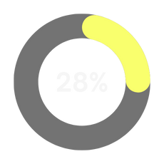
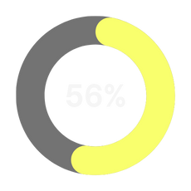
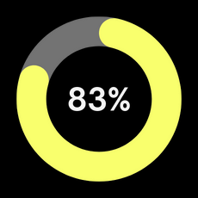
Key Performance Indicators
KPI #1
KPI #2
KPI #3
A marketing plan is a strategic blueprint that outlines an organization's approach to promoting its products or services to its target audience.
A marketing plan is a strategic blueprint that outlines an organization's approach to promoting its products or services to its target audience.
A marketing plan is a strategic blueprint that outlines an organization's approach to promoting its products or services to its target audience.
22

Slide 23
Meet Our Team
A marketing plan is a strategic blueprint that outlines an organization's approach to promoting its products or services to its target audience.
23

Slide 24




Get in Touch
Phone
Email Address
Social Media
www.reallygreatsite.com
24

